Slide 1





Built-in Functions
Functions and Wildcards
in SQL Server
Functions
& Wildcards
Viktor Kostadinov
Technical Trainer
Software University
http://softuni.bg

Slide 2

Table of Contents
Function Overview
String Functions
Math Functions
Date Functions
Other Useful Functions
Wildcards

Slide 3

Functions in SQL Server

Slide 4

SQL Functions
String Functions – for manipulating text, both from table values or user input
E.g. concatenate column values
Math Functions – calculations and working with aggregate data
E.g. perform geometry and currency operations
Date and Time Functions
E.g. find length of timespan
Miscellaneous Functions

Slide 5

String Functions

Slide 6
String Functions
Concatenation – combine strings
CONCAT replaces NULL values it with empty string
SELECT FirstName + ' ' + LastName
AS [Full Name]
FROM Employee
SELECT CONCAT(FirstName, ' ', LastName)
AS [Full Name]
FROM Employee

Slide 7
String Functions (2)
SUBSTRING – extract part of a string
Example: get short summary of article
SUBSTRING(String, StartIndex, Length)
Index is 1-based!
SELECT ArticleId, Author, Content,
SUBSTRING(Content, 1, 200) + '...' AS Summary
FROM Articles

Slide 8
String Functions (3)
REPLACE – replace specific string with another
Example: censor the word blood from album names
REPLACE(String, Pattern, Replacement)
SELECT REPLACE(Title, 'blood', '*****')
AS Title
FROM Album

Slide 9
String Functions (4)
LTRIM & RTRIM – remove spaces from either side of string
LEN – count number of characters
DATALENGHT – get number of used bytes (double for Unicode)
LTRIM(String)
RTRIM(String)
LEN(String)
DATALENGTH(String)

Slide 10
String Functions (5)
LEFT & RIGHT – get characters from beginning or end of string
Example: name shorthand (first 3 letters)
LEFT(String, Count)
RIGHT(String, Count)
SELECT Id, Start,
LEFT(Name, 3) AS Shorthand
FROM Games

Slide 11
Problem: Obfuscate CC Numbers
Our database contains credit card details for customers
Provide a summary without revealing the serial numbers
ID | FirstName | LastName | PaymentNumber
1 | Guy | Gilbert | 5645322227179083
2 | Kevin | Brown | 4417937746396076
… | … |  | …
ID | FirstName | LastName | PaymentNumber
1 | Guy | Gilbert | 564532**********
2 | Kevin | Brown | 441793**********
… | … |  | …

Slide 12
Solution : Obfuscate CC Numbers
We reveal the first 6 digits and obfuscate the rest
Bonus – create View for use by client apps
SELECT CustomerID,
FirstName,
LastName,
LEFT(PaymentNumber, 6) + '**********'
FROM Customers
CREATE VIEW v_PublicPaymentInfo AS
…

Slide 13
String Functions (6)
LOWER & UPPER – change letter casing
REVERSE – reverse order of all characters in string
REPLICATE – repeat string
LOWER(String)
UPPER(String)
REVERSE(String)
REPLICATE(String, Count)

Slide 14
String Functions (7)
CHARINDEX – locate specific pattern (substring) in string
STUFF – insert substring at specific position
If omitted, begins at 1
CHARINDEX(Pattern, String, [StartIndex])
STUFF(String, StartIndex, Length, Substring)
Number of character
to delete

Slide 15

Math Functions

Slide 16
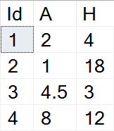
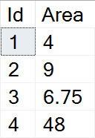
Math Functions
Basic arithmetic operations
Example: find area of triangles by given side and height
SELECT Id,
(A*H)/2 AS Area
FROM Triangles

Slide 17
Math Functions (2)
PI – get the value of Pi as float (15 –digit precision)
ABS – absolute value
SQRT – square root (result will be float)
SQUARE – raise to power of two
SELECT PI() --3.14159265358979
ABS(Value)
SQRT(Value)
SQUARE(Value)

Slide 18
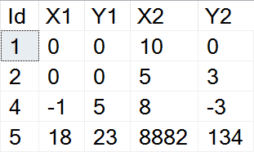
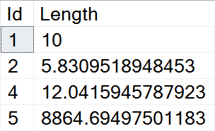
Example: Line Length
Find the length of a line by given coordinates of end points
SELECT Id,
SQRT(SQUARE(X1-X2) + SQUARE(Y1-Y2))
AS Length
FROM Lines

Slide 19
Math Functions (3)
POWER – raise value to desired exponent
ROUND – obtain desired precision
FLOOR & CEILING – return the nearest integer
POWER(Value, Exponent)
Can be negative
ROUND(Value, Precision)
FLOOR(Value)
CEILING(Value)

Slide 20
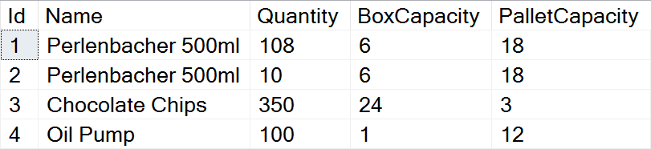
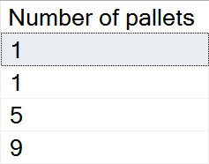
Problem: Pallets
Calculate the required number of pallets to ship each item
BoxCapacity specifies how many items can fit in one box
PalletCapacity specifies how many boxes can fit in a pallet

Slide 21
Solution : Pallets
Since we can't use half a box or half a pallet, we need to round up to the nearest integer value
SELECT
CEILING(
CEILING(
CAST(Quantity AS float) /
BoxCapacity) / PalletCapacity)
AS [Number of pallets]
FROM Products

Slide 22
Math Functions (4)
SIGN – returns +1, -1 or 0, depending on value sign
RAND – get a random float value in range [0,1)
If Seed is not specified, one is assigned at random
SIGN(Value)
RAND()
RAND(Seed)

Slide 23

Date Functions

Slide 24
Date Functions
DATEPART – extract a segment from a date as an integer
Part can be any part and format of date or time
For a full list, see the official documentation
DATEPART(Part, Date)
year, yyyy, yy
YEAR(Date)
month, mm, m
MONTH(Date)
day, dd, d
DAY(Date)

Slide 25
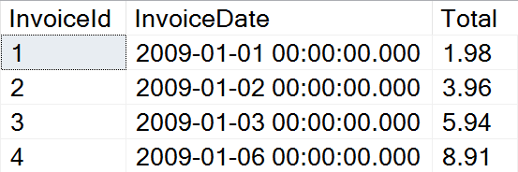
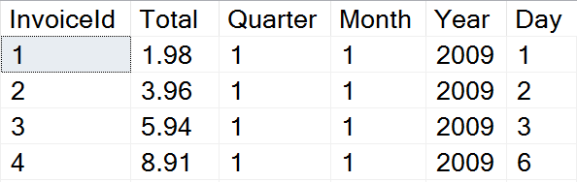
Problem: Quarterly Report
Prepare sales data for aggregation by displaying yearly quarter, month, year and day of sale

Slide 26
Solution: Quarterly Report
Use DATEPART to get the relevant parts of the date
This statement might be useful as a View
SELECT InvoiceId, Total,
DATEPART(quarter, InvoiceDate) AS Quarter,
DATEPART(month, InvoiceDate) AS Month,
DATEPART(year, InvoiceDate) AS Year,
DATEPART(day, InvoiceDate) AS Day
FROM Invoice

Slide 27
Date Functions (2)
DATEDIFF – find difference between two dates
Part can be any part and format of date or time
Example: Show employee experience
DATEDIFF(Part, FirstDate, SecondDate)
SELECT ID, FirstName, LastName,
DATEDIFF(year, HireDate, '2017/01/25')
AS [Years In Service]
FROM Employees

Slide 28
Date Functions (3)
DATENAME – get a string representation of a date's part
DATEADD – perform date arithmetic
Part can be any part and format of date or time
GETDATE – obtain current date and time
DATENAME(Part, Date)
SELECT DATENAME(weekday, '2017/01/27')
DATEADD(Part, Number, Date)
SELECT GETDATE()

Slide 29


Other Functions

Slide 30
Other Functions
CAST & CONVERT – convert between data types
ISNULL – swap NULL values with a specified default value
Example: Display Not Finished for projects with no EndDate
CAST(Data AS NewType)
CONVERT(NewType, Data)
ISNULL(Data, DefaultValue)
SELECT ProjectID, Name,
ISNULL(CAST(EndDate AS varchar), 'Not Finished')
FROM Projects

Slide 31
Other Functions(2)
OFFSET & FETCH – get only specific rows from the result set
Used in combination with ORDER BY for pagination
SELECT ID, FirstName, LastName
FROM Employees
ORDER BY ID
OFFSET 10 ROWS
FETCH NEXT 5 ROWS ONLY
Rows to skip
Rows to include

Slide 32
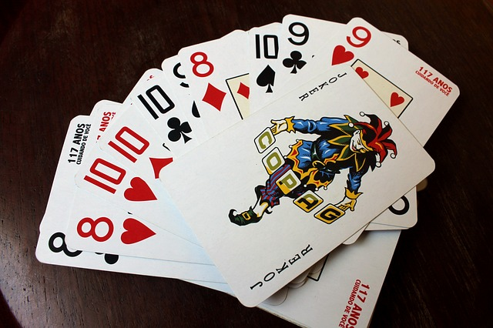
Wildcards
Selecting results by partial match

Slide 33
Using WHERE … LIKE
Wildcards are used with WHERE to filter for partial match
Similar to Regular Expressions
Example: Find all employees who's first name starts with "Ro"
SELECT ID, FirstName, LastName
FROM Employees
WHERE FirstName LIKE 'Ro%'
Wildcard symbol

Slide 34
Wildcard Characters
Supported characters include
ESCAPE – specify prefix to treat special characters as normal
% --any string, including zero-length
_ --any single character
[…] --any character within range
[^…] --any character not in the range
SELECT ID, Name
FROM Tracks
WHERE Name LIKE '%max!%' ESCAPE '!'

Slide 35

Summary
SQL Server provides various built-in functions
Using Wildcard, we can obtain results by partial string matches
SELECT ID, FirstName, LastName,
DATEDIFF(year, HireDate, '2017/01/25')
AS [Years In Service]
FROM Employees

Slide 36








Built-in Functions
https://softuni.bg/courses/

Slide 37
License
This course (slides, examples, demos, videos, homework, etc.) is licensed under the "Creative Commons Attribution-NonCommercial-ShareAlike 4.0 International" license
Attribution: this work may contain portions from
"Databases" course by Telerik Academy under CC-BY-NC-SA license

Slide 38




Free Trainings @ Software University
Software University Foundation – softuni.org
Software University – High-Quality Education, Profession and Job for Software Developers
softuni.bg
Software University @ Facebook
facebook.com/SoftwareUniversity
Software University Forums
forum.softuni.bg

